Slide 1
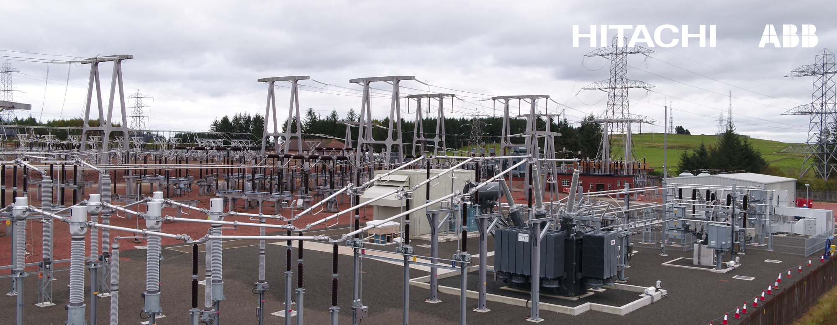


Dynamic Reactive Power Compensation (DRPC) overview
Enabling a Stronger, Smarter and Greener Grid | Conny Wahlberg & Mikael Halonen, WETEX 2021; October 6, 2021

Slide 2
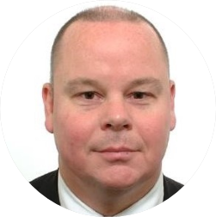
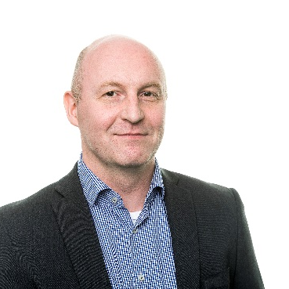
Dynamic Reactive Power Compensation
Presenters
Conny Wahlberg
Mikael Halonen
Sales & Marketing Manager
Middle East & Africa
Grid and Power Quality Solutions
Head of Application Engineering
Grid and Power Quality Solutions
conny.wahlberg@hitachi-powergrids.com
mikael.halonen@hitachi-powergrids.com

Slide 3
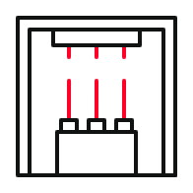



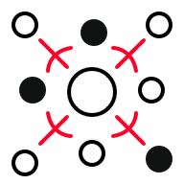
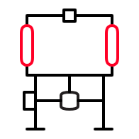

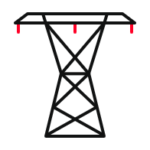

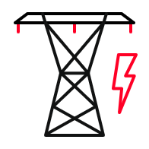
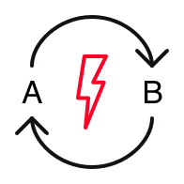
The changing power landscape
Many drivers – one common need
Generation
Consumers
Increasing energy production
Increasing power consumption
Integration of renewables
New grids in emerging markets
Need for good Power Quality
Deal with distributed generation
Faster and stronger
transportation systems
Transmission and Distribution
Aging infrastructure
Changing regulations
grid code compliance
Energy trading between regions
Reversible
power flow

Slide 4
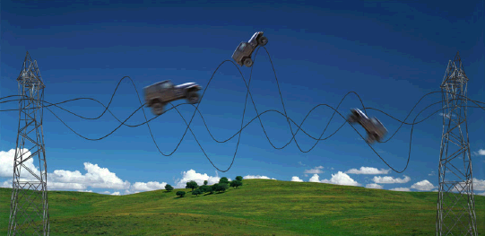
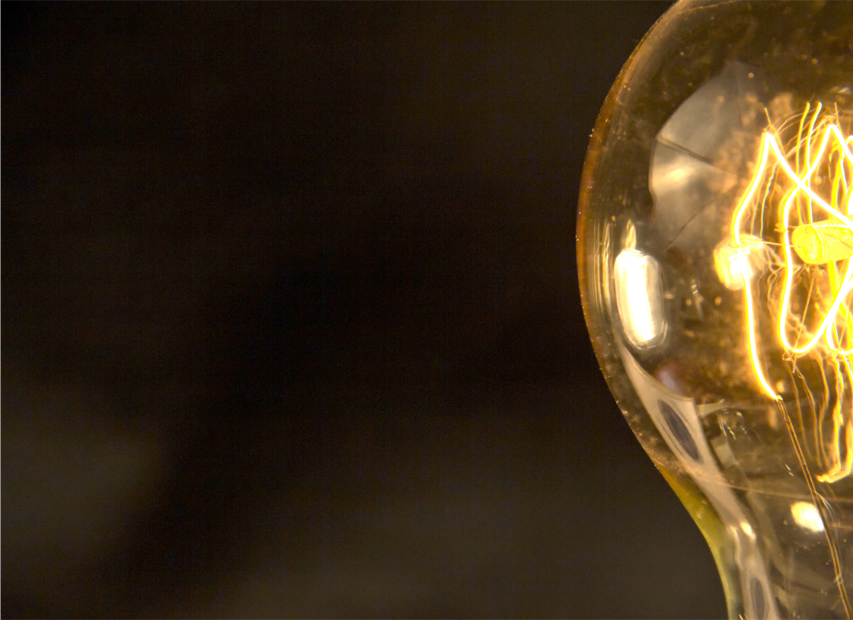
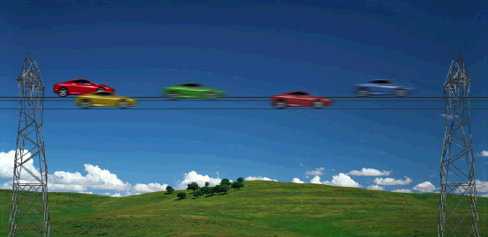
Power Quality – FACTS
Flexible AC Transmission Systems
Power grids under optimum conditions:
Increase transmission capacity
Improve grid stability
More power can reach consumers:
Minimum environmental impact
Shorter project implementation
Lower investment cost
Hitachi ABB Power Grids:
Worldwide leader
Complete Power Quality portfolio
All key equipment in-house
Reliable supplier
Power Quality technologies pave the transmission highway

Slide 5
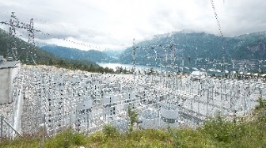
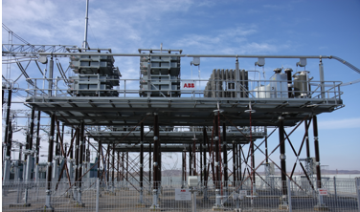

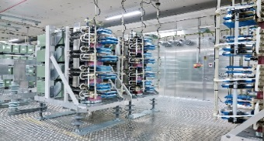

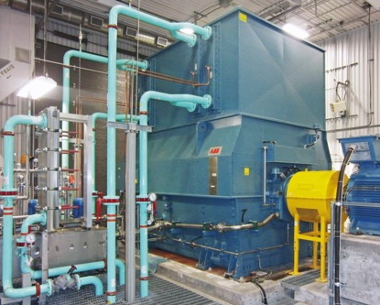
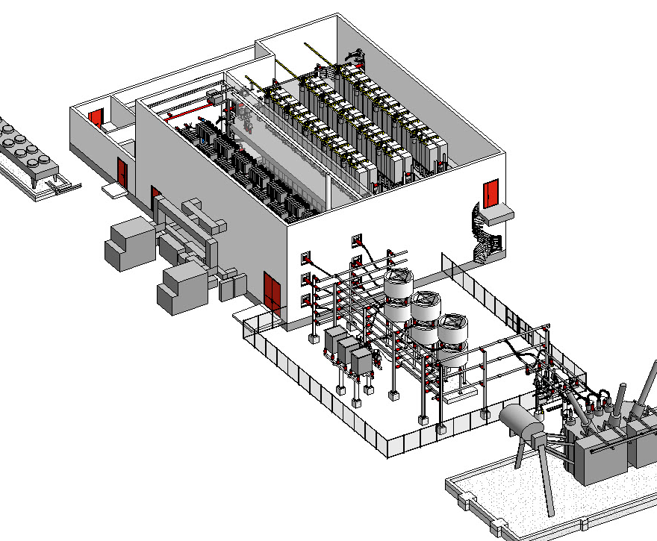
Power Quality – FACTS
Portfolio
Dynamic Shunt Compensation
Series Compensation
Static Frequency Conversion
SVC Classic
Improved voltage control and power quality
Load balancing
Flicker mitigation
Increased productivity
STATCOM
Similar benefits as for SVC Classic
More robust in weak grids
Higher performance flicker mitigation
Reduced footprint
Synchronous Condenser
Increase of short circuit power
Increased network inertia
Voltage fluctuation damping
(+/- Mvar control)
E-STATCOM
Similar benefits as for STATCOM
Increased network inertia
Increase of short circuit power
Fixed Series Compensation
Increased power transfer capability
Improved voltage and transient stability
Improved voltage profile along the line
Thyristor Controlled Series Compensation (TCSC)
Power oscillation damping (POD)
Inherent immunity against sub synchronous resonance (SSR)
Dynamic power flow control
Series Reactors
Short-circuit current limiter
Power flow control
Rail Static Frequency Converter (SFC)
Active power in-feeding 3 phases-1 phase to 16,7/25Hz, 50/60 Hz
Full decoupling of grids
Independent, fast control of frequency, voltage, active and reactive power on both sides
Connection to weak grids

Slide 6
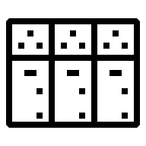
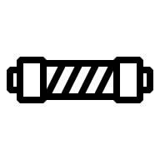
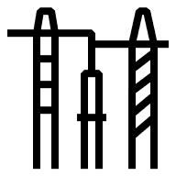
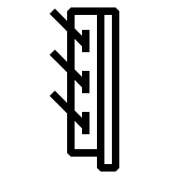
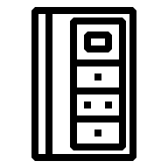

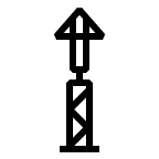

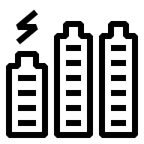
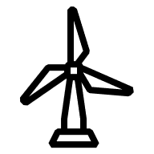
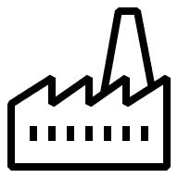
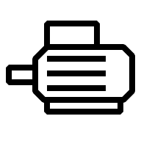


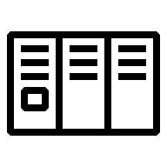




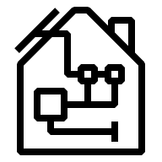
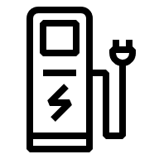

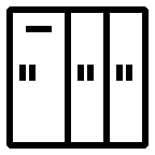


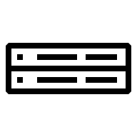
Power Quality – FACTS
Applications & locations
Generation
Grid
Industry and large commercial
HVDC link
STATCOM/
SVC
Passive
filter
Series
Compensation
Shunt
capacitor
Shunt
reactor
Surge arrester
and relay
Series
reactor
STATCOM/
SVC
Active filter/ Shunt capacitor
Passive
filter
Shunt
reactor
BESS or
UPS
Surge
arrester
and relay
Transmission grid
Offshore Wind parks
or distant generation
Series
compensation
Passive
filter
Energy
intensive
Industry
Synchronous condenser
DMS
Storage
STATCOM/
SVC
Passive
filter
Shunt
reactor
Line voltage regulator
Storage
Smart Data/ Control Center ADMS, AVVMS
MV or LV
Active filter/ Shunt capacitor
Passive
filter
BESS or
UPS
Surge
arrester
and relay
Tap
changers
Renewable generation
Volt/Var Control
Industry/
large
commercial
Residential and small commercial
MV line Regulator
Surge arrestor and relay
Transportation
MicroSCADA
MV
BESS or
UPS
STATCOM/
SVC
Active filter/ Shunt capacitor
Passive
filter
Shunt
reactor
Surge arrester
and relay
Storage
Active filter/ Shunt capacitor
LV
Distr.
Grid
TropOS
Tap changer
STATIC Frequency converter
Single phase network
(DC, 50 Hz or 16.7 Hz)
RTU500
Passive filter Shunt capacitor
G

Slide 7
Power Quality – FACTS
Portfolio
Dynamic Shunt Compensation
Series Compensation
Static Frequency Conversion
SVC Classic
Improved voltage control and power quality
Load balancing
Flicker mitigation
Increased productivity
STATCOM
Similar benefits as for SVC Classic
More robust in weak grids
Higher performance flicker mitigation
Reduced footprint
Synchronous Condenser
Increase of short circuit power
Increased network inertia
Voltage fluctuation damping
(+/- Mvar control)
E-STATCOM
Similar benefits as for STATCOM
Increased network inertia
Increase of short circuit power
Fixed Series Compensation
Increased power transfer capability
Improved voltage and transient stability
Improved voltage profile along the line
Thyristor Controlled Series Compensation (TCSC)
Power oscillation damping (POD)
Inherent immunity against sub synchronous resonance (SSR)
Dynamic power flow control
Series Reactors
Short-circuit current limiter
Power flow control
Rail Static Frequency Converter (SFC)
Active power in-feeding 3 phases-1 phase to 16,7/25Hz, 50/60 Hz
Full decoupling of grids
Independent, fast control of frequency, voltage, active and reactive power on both sides
Connection to weak grids

Slide 8
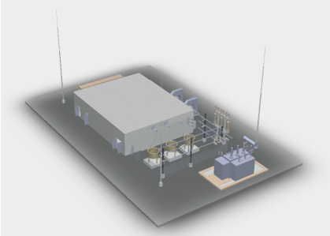
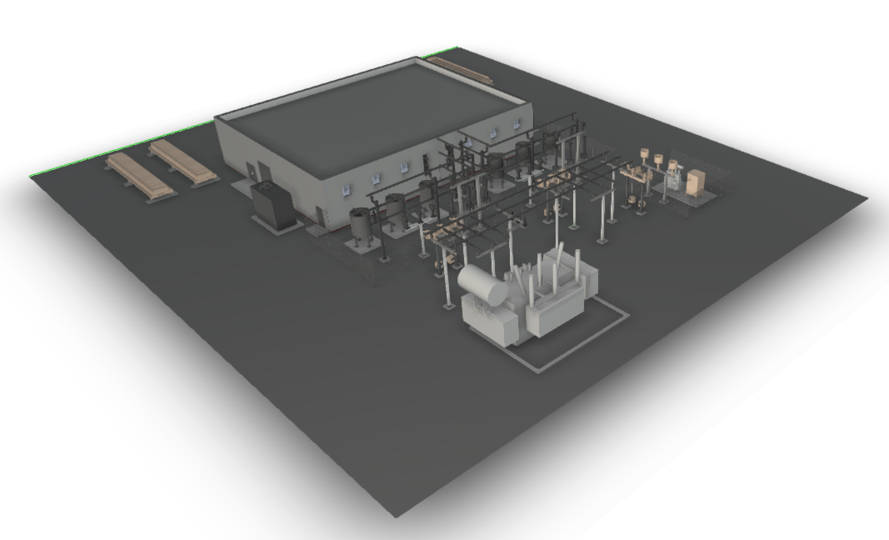
STATCOM technology
Yesterday
Today
Traditional STATCOM
    Multiple VSC Branches over 150 MVAR
Traditional STATCOM
    Single Branch up to 425 MVAR
Grid Forming, Inertia, Active Filtering, Multiple topologies
Larger Capacity → Reduced Footprint → Increased Functionality

Slide 9


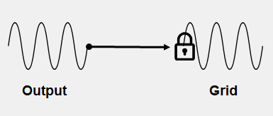
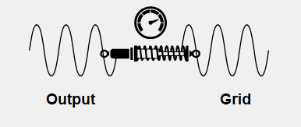
STATCOM Technology
Increased Functionality - Comparison: Grid Following vs. Grid Forming
Grid Following (GFL) behavior
Grid Forming (GFM) behavior
Current source
Controllable voltage source
  Relying on the voltage provided by the grid
  No instantaneous support for voltage and frequency stability
  Instantaneous support for voltage
  Instantaneous support for frequency (SVC Light ® Enhanced)
  Contribution to system stability

Slide 10
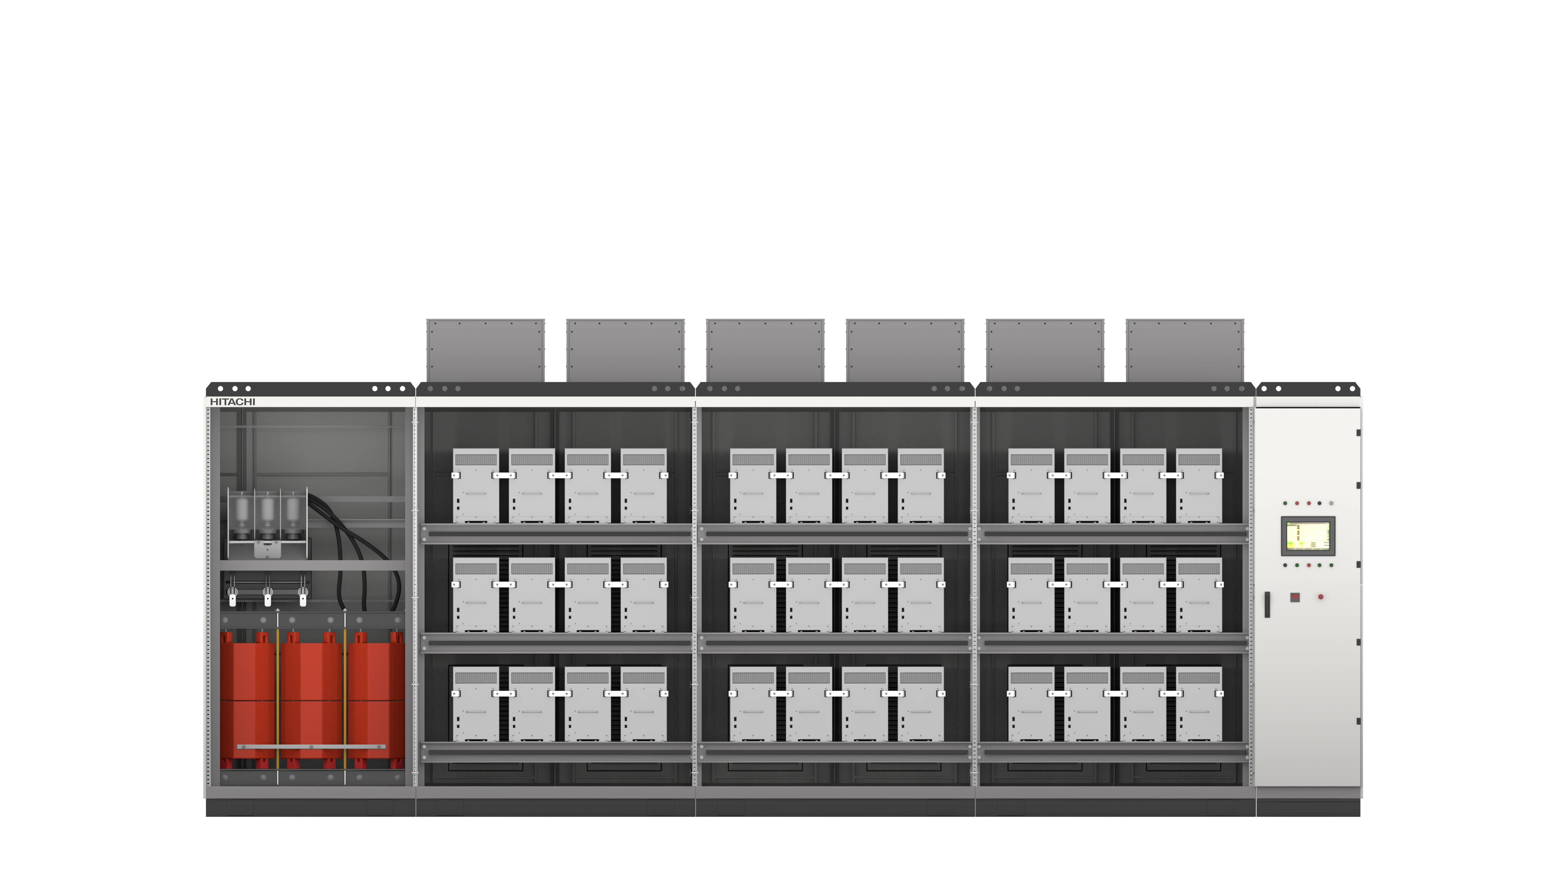
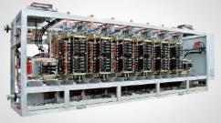
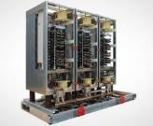
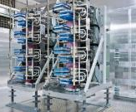
Hitachi ABB PG STATCOM Portfolio
Overview
Complete STATCOM portfolio from
3
IGBT
IGCT
IGCT
IGBT
MVar
± 3MVar ~ ± 20 MVar
± 20MVar ~ ± 40MVar
± 50MVar ~ ± 125MVar
± 100MVar ~ ± 425MVar
Up to
STATCOM
for Distributed Power
PCS 6000
SVC Light®
425
Range and configuration
Selection criteria
MVar
with one single
converter
The ranges of the different STATCOMs are not rigid, meaning that they might overlap their ”specific ranges”
Parallel connection of SVC Light® MP may be used for selected projects as alternative to SVC Light® HP or two PCS6000 in parallel can be an alternative to one SVC Light® MP
The selection of converter solution should be done related to:
Capability of fulfilling application requirements in optimal way
Impact on other subsystems for optimizing the overall system cost, footprint, reliability and losses

Slide 11
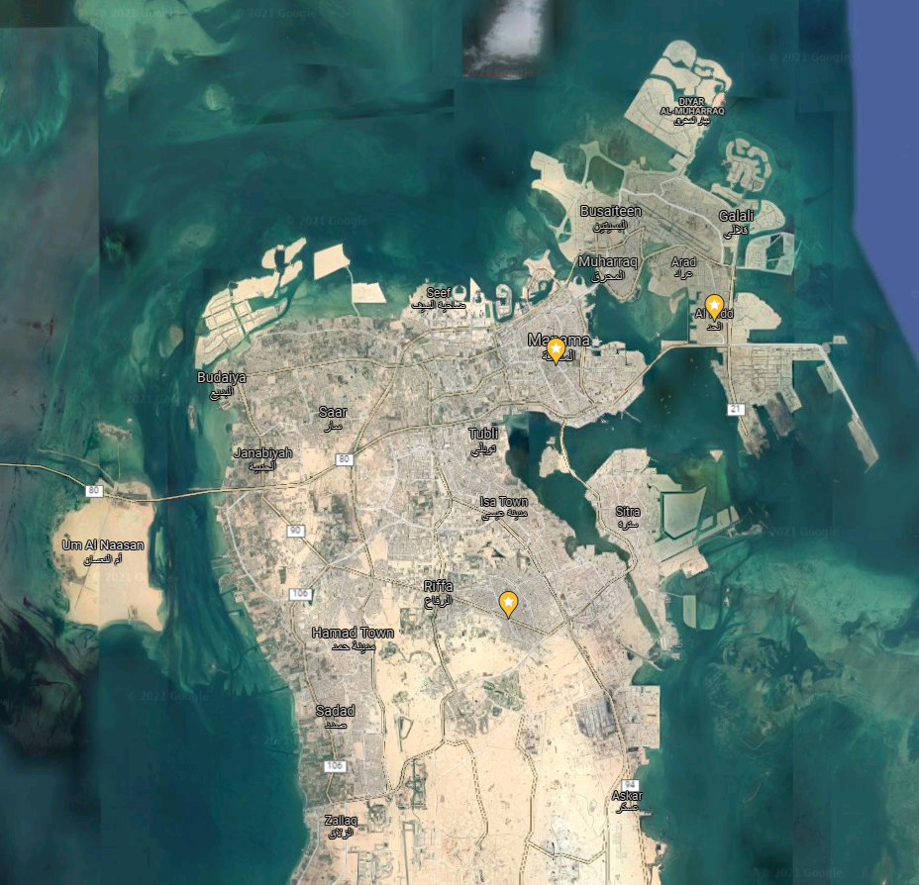
Manama, Riffa and Hidd STATCOMs to EWA, BH
Case study
EWA’s needs
Despite improvements in the network, e.g. the introduction of a 400 kV ring system, the system is prone to voltage collapse and delayed voltage recovery, involving power station outages, excessive motor stalling and load shedding. Therefore, EWA decided to install STATCOMs to mitigate voltage instabilities and to establish reliable power supply.
HAPG’s response
Turnkey delivery of three 220 kV STATCOMs, each rated -200/+200 Mvar
Contract awarded in June 2021
Less than two years delivery time
EWA’s benefits
Fully dynamic Mvars ensuring mitigation of voltage instabilities and reliable power supply
Unprecedented availability (>99.7% guaranteed) from one-branch VSC design with embedded redundancy
Single-branch VSC vouches for lowest maintenance and smallest footprint compared to other dynamic var solutions
Hidd
Manama
Riffa

Slide 12
Power Quality – FACTS
Portfolio
Dynamic Shunt Compensation
Series Compensation
Static Frequency Conversion
SVC Classic
Improved voltage control and power quality
Load balancing
Flicker mitigation
Increased productivity
STATCOM
Similar benefits as for SVC Classic
More robust in weak grids
Higher performance flicker mitigation
Reduced footprint
Synchronous Condenser
Increase of short circuit power
Increased network inertia
Voltage fluctuation damping
(+/- Mvar control)
E-STATCOM
Similar benefits as for STATCOM
Increased network inertia
Increase of short circuit power
Fixed Series Compensation
Increased power transfer capability
Improved voltage and transient stability
Improved voltage profile along the line
Thyristor Controlled Series Compensation (TCSC)
Power oscillation damping (POD)
Inherent immunity against sub synchronous resonance (SSR)
Dynamic power flow control
Series Reactors
Short-circuit current limiter
Power flow control
Rail Static Frequency Converter (SFC)
Active power in-feeding 3 phases-1 phase to 16,7/25Hz, 50/60 Hz
Full decoupling of grids
Independent, fast control of frequency, voltage, active and reactive power on both sides
Connection to weak grids

Slide 13
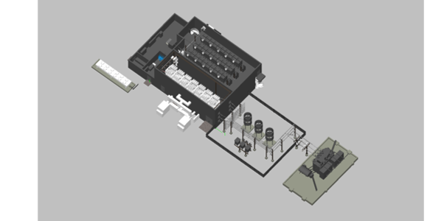
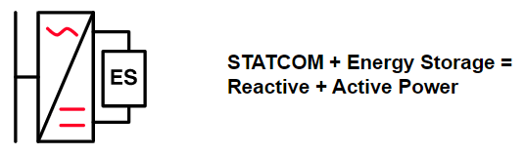
E-STATCOM – SVC Light® Enhanced
Building on Hitachi ABB Power Grids’ proven STATCOM technology,
SVC Light®​
Integrating supercapacitors for energy storage – contributing with
active power​
Combining the advantages of two grid-stabilizing technologies into
one solution – providing both active and reactive power​
Offer multiple grid-stabilizing services – in a single solution​
Reducing the risk that unexpected system events will be causing
more severe frequency disturbances than seen today​
Features
Fast voltage/ frequency support​
Synthetic inertia​
Fault current generation​
System strength support​
​Capabilities​
Up to over 400 Mvar in a
single system​
Grid-forming control​
Scalable energy storage
capacity in the hundreds
of MWs

Slide 14
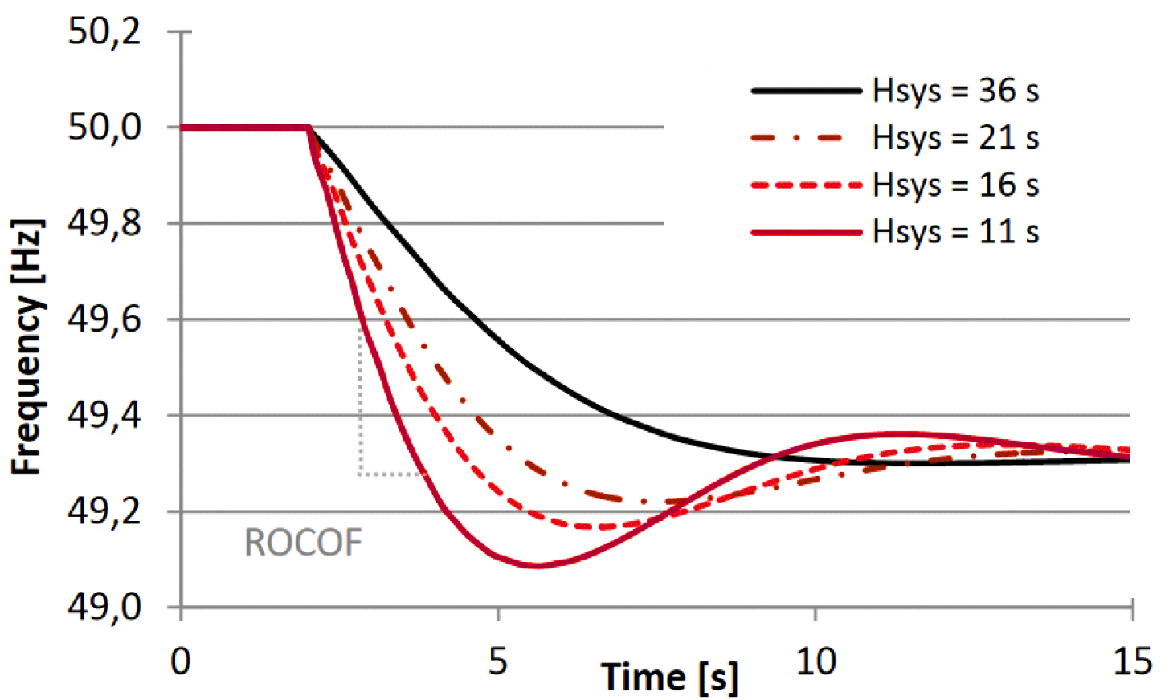
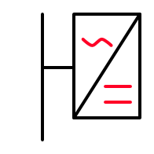
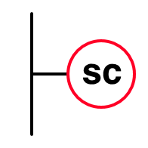
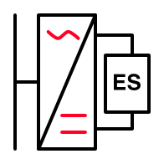
SVC Light® Enhanced Concept
Problems with more renewables?
Frequency variations
Comparison
Lower short-circuit power
  deeper and widespread voltage dips for grid faults
  Lower power quality (larger voltage variations)
Lower inertia
  Grid fault resulting in reduced generated power (power plant or line)
  Power imbalance results in reduced frequency:
    Frequency change (slope)
    Frequency deviation
  At too high frequency change and too low frequency, loads and generators are disconnected from power system
  Lower inertia results in quicker frequency variations
Potential solutions to add inertia to increase stability:
Grid-stabilizing services | Traditional STATCOM | Synchronous condenser | SVC Light® Enhanced
Voltage regulation
Inertia
Short-circuit current contribution
Flexibility/ modularity
Controllability
Synchronous Condenser
STATCOM
Enhanced STATCOM:
  STATCOM (SVC Light®)
  Energy storage
  Advanced controller

Slide 15
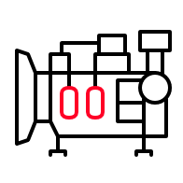
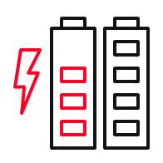

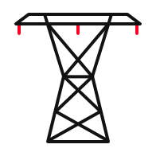




What services are required to operate a stable and secure grid?
Synchronous Generators
Synchronous Generators
Grid Forming BESS (VSM)
Enhanced STATCOM
Grid Forming BESS (VSM)
Inertia
System strength
Steady operation
during normal
operation and during
disturbances.
Limits rapid rate of
Change of system
frequency (RoCoF).
Associated with
fault levels and
short circuit ratios.
Operate the system
securely and ensure safe protection systems.
Required for fault ride through and recovery from faults.
Synchronous Condensers
Enhanced STATCOM
HVDC with voltage source converter
New wind farms with controls
Synchronous Condensers
BESS
FFR
Frequency control
Synchronous Generators
Balancing load & generation.
After a frequency disturbance, control required in different timescales.
(<1 sec, up to 60 sec,
1 to 5 min, >5 min)
Stable operation during normal conditions.
Assist in fault ride through and recovery during disturbances.
Voltage control
Synchronous Generators
BESS
HVDC with voltage source converter
Synchronous Condensers
Enhanced STATCOM
SVCs/ STATCOM/Enhanced STATCOM
New wind farms with controls
Capacitors/ Reactors
Load shedding
Load shedding
Enhanced STATCOM can provide multiple services in a cost effective way

Slide 16

Easy access to more in-dept material
https://www.hitachiabb-powergrids.com/offering/product-and-system/facts

